Slide 1
BB2950 Day 23: Tuesday 12-5-17
Learning objectives:
Explain the role of aminoacyl-tRNA synthetases (continued from day 22).
Describe the chemical linkage between amino acids and tRNAs.
Describe how translation is initiated in prokaryotes, including mRNA recognition and the roles of initiation factors.
Describe how translation is initiated in eukaryotes, including mRNA recognition and the roles of initiation factors.
Describe the steps in which hydrolysis of energy-carriers (ATP and GTP) is required to power translation.
Describe the process of elongation, including the roles of elongation factors EF-Tu, EF-Ts, and EF-G.
Describe the chemical basis of peptide bond formation.
Microphone

Slide 2
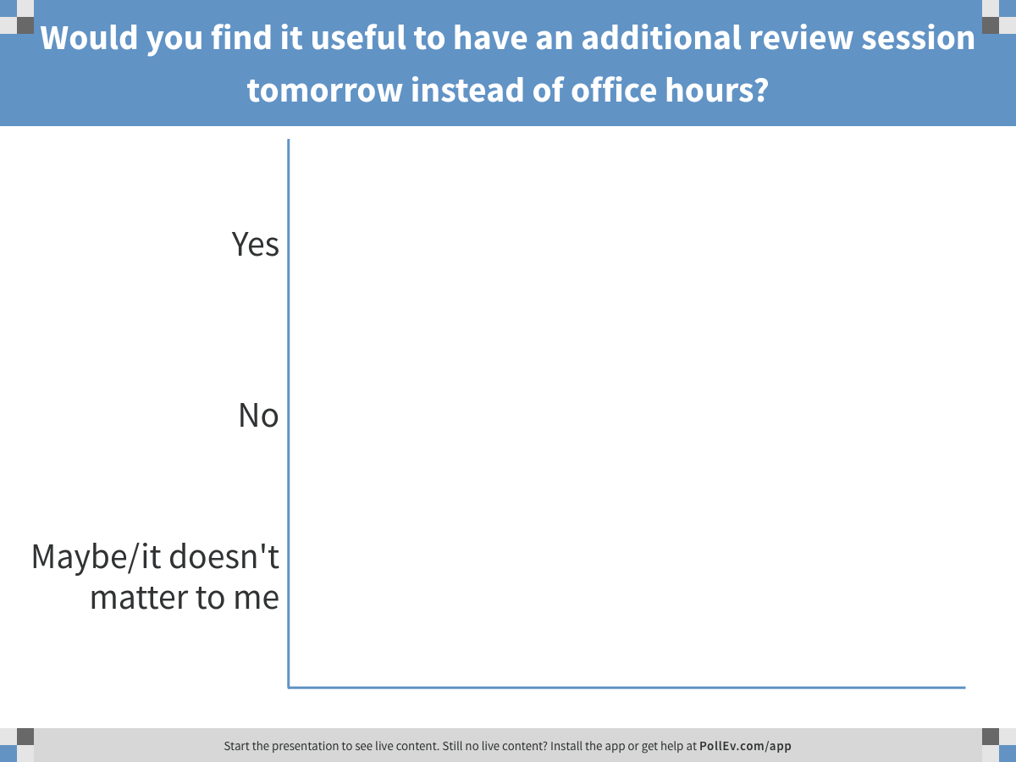
Notes:
Would you find it useful to have an additional review session tomorrow instead of office hours?
https://www.polleverywhere.com/multiple_choice_polls/8HJtYwEG730s1rd

Slide 3
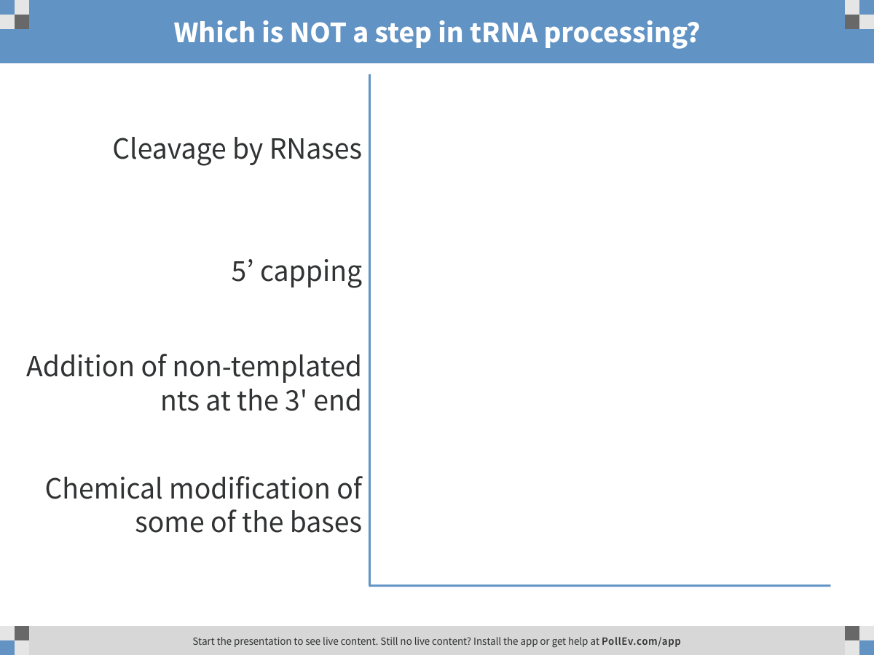
Notes:
Which is NOT a step in tRNA processing?
https://www.polleverywhere.com/multiple_choice_polls/teTljn7LpOugfvt

Slide 4
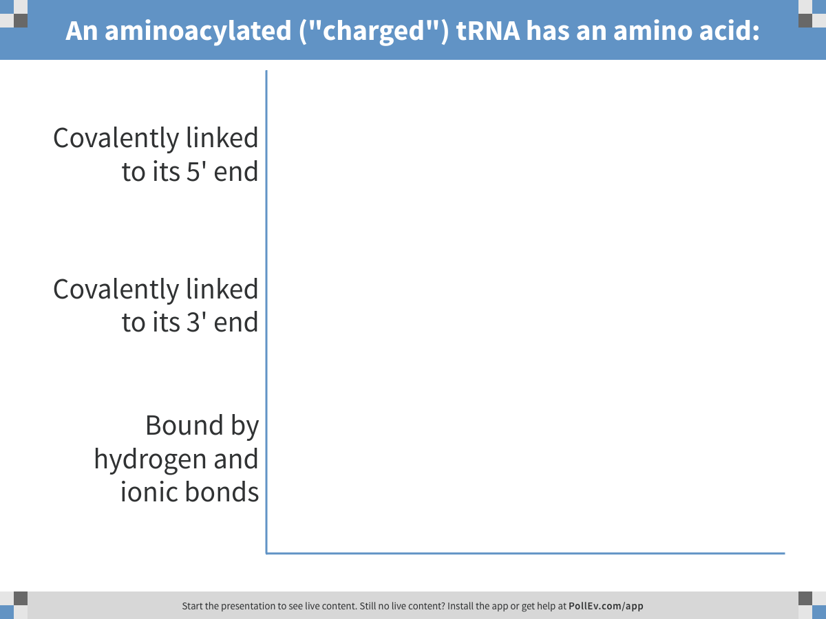
Notes:
An aminoacylated ("charged") tRNA has an amino acid:
https://www.polleverywhere.com/multiple_choice_polls/zwkHfdx6E8Cr68A

Slide 5
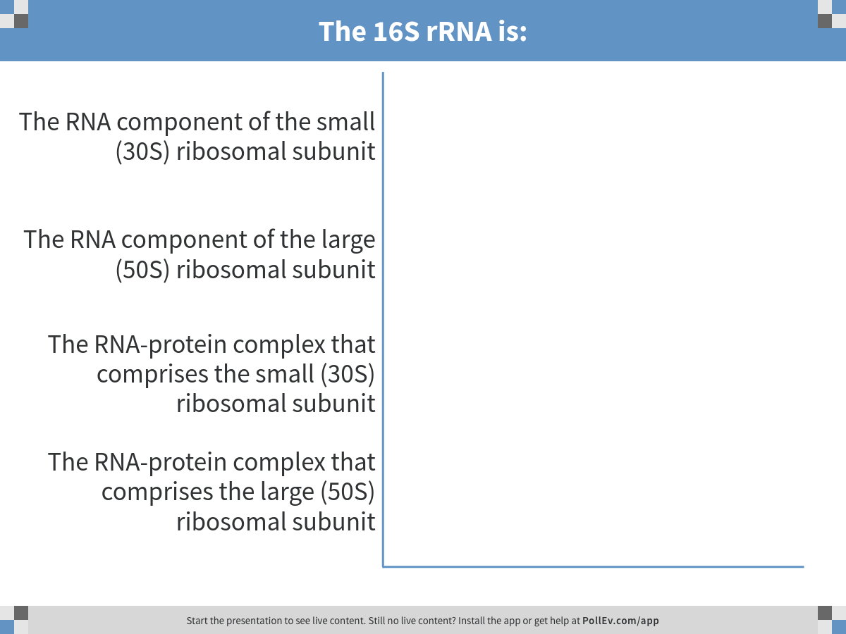
Notes:
The 16S rRNA is:
https://www.polleverywhere.com/multiple_choice_polls/WLjVRcls2doW7tW

Slide 6
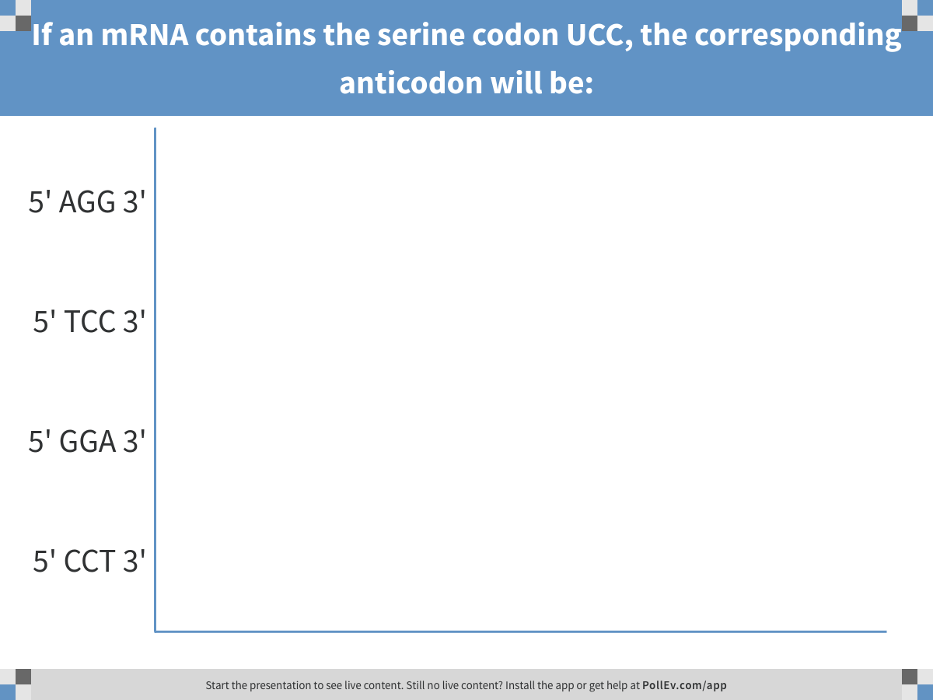
Notes:
If an mRNA contains the serine codon UCC, the corresponding anticodon will be:
https://www.polleverywhere.com/multiple_choice_polls/eilRk6J6YgwStAc

Slide 7
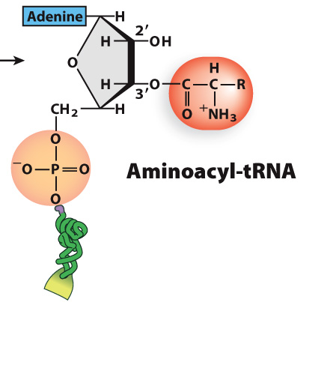
Aminoacyl-tRNA synthetases are enzymes that covalently link amino acids to the 3’ ends of tRNAs

Slide 8
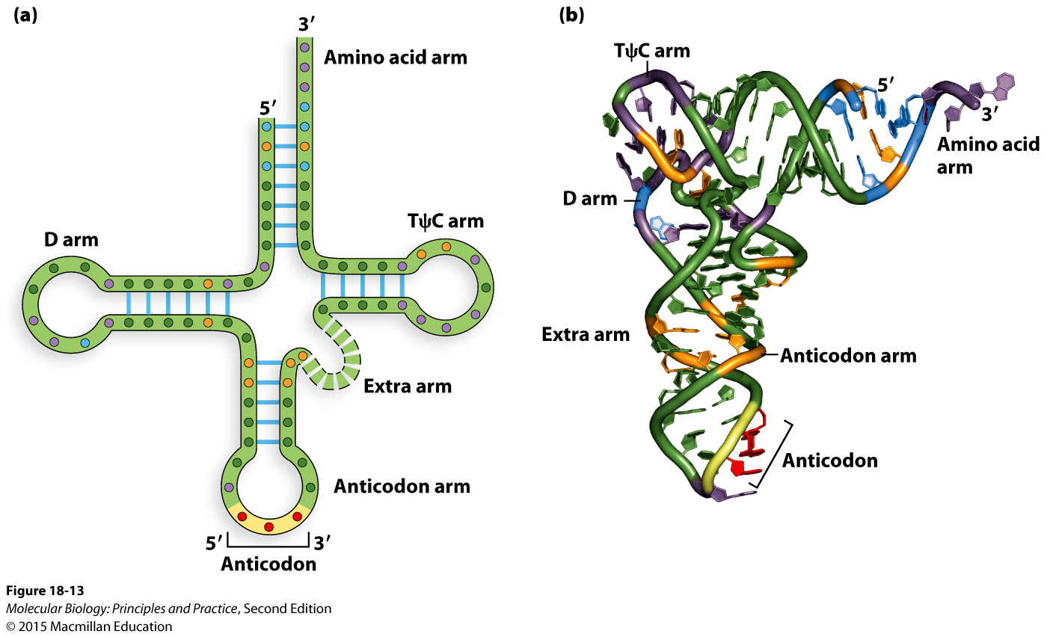
Aminoacyl-tRNA synthetases recognize many different nucleotides in the tRNA (not just anticodon)

Slide 9
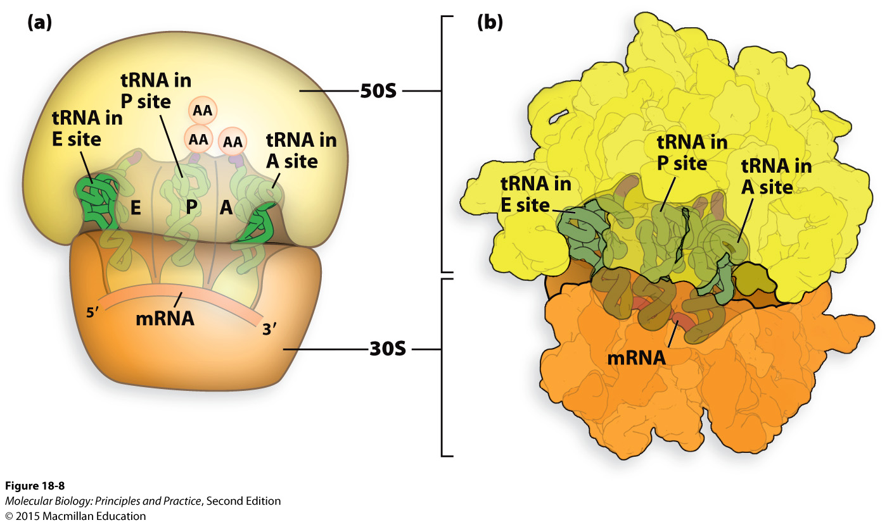
Ribosomes have three tRNA binding sites

Slide 10
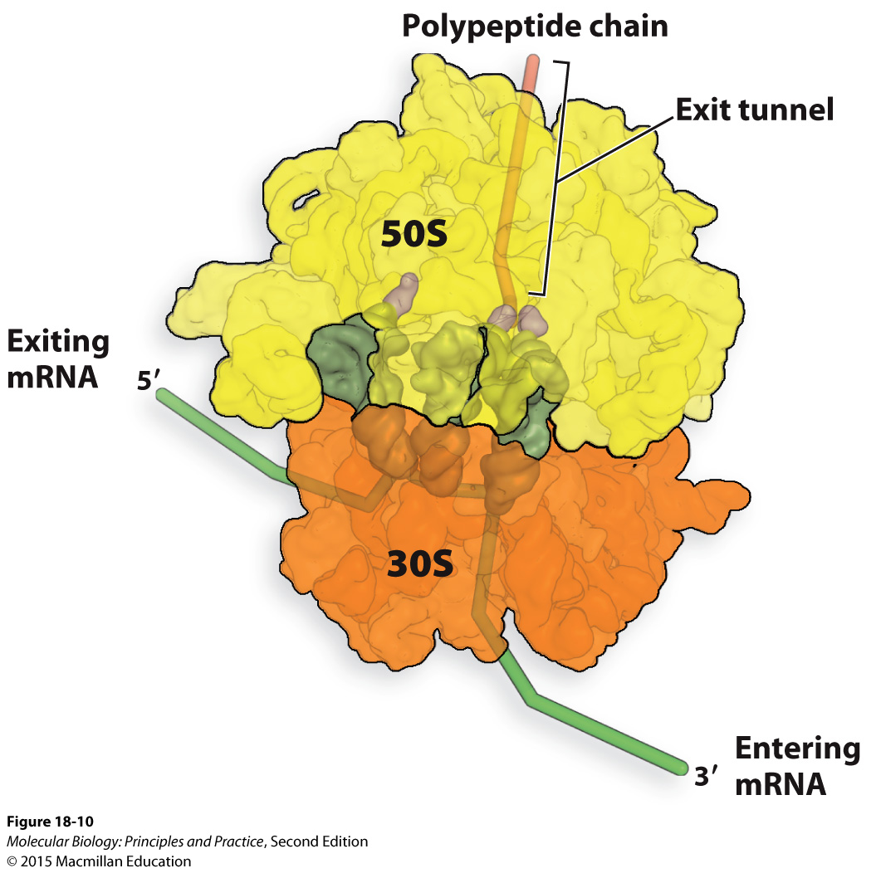

Slide 11
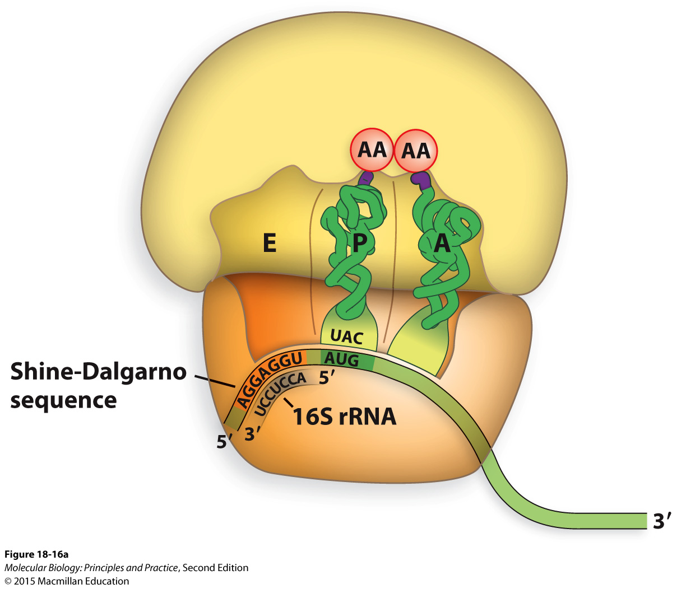
Initiation of translation in bacteria usually requires a Shine-Dalgarno sequence

Slide 12
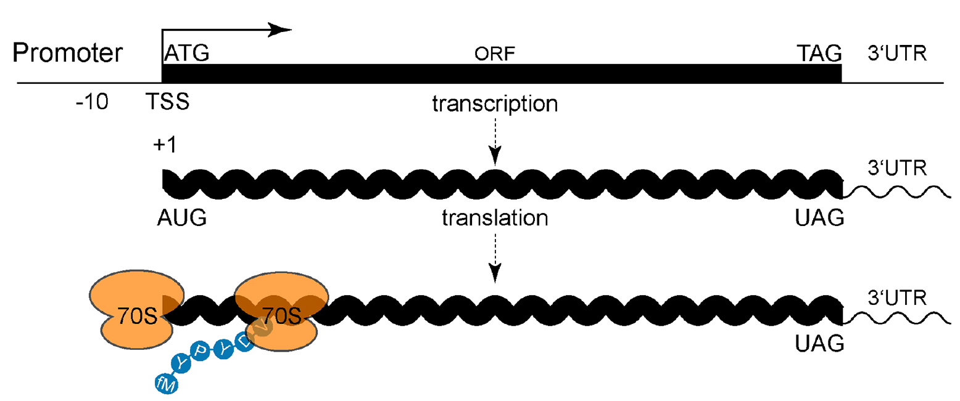
Some bacteria can efficiently translate “leaderless” transcripts that start with AUG
Shell, Wang, et al. (2015). PLoS Genetics, 11(11), e1005641.

Slide 13
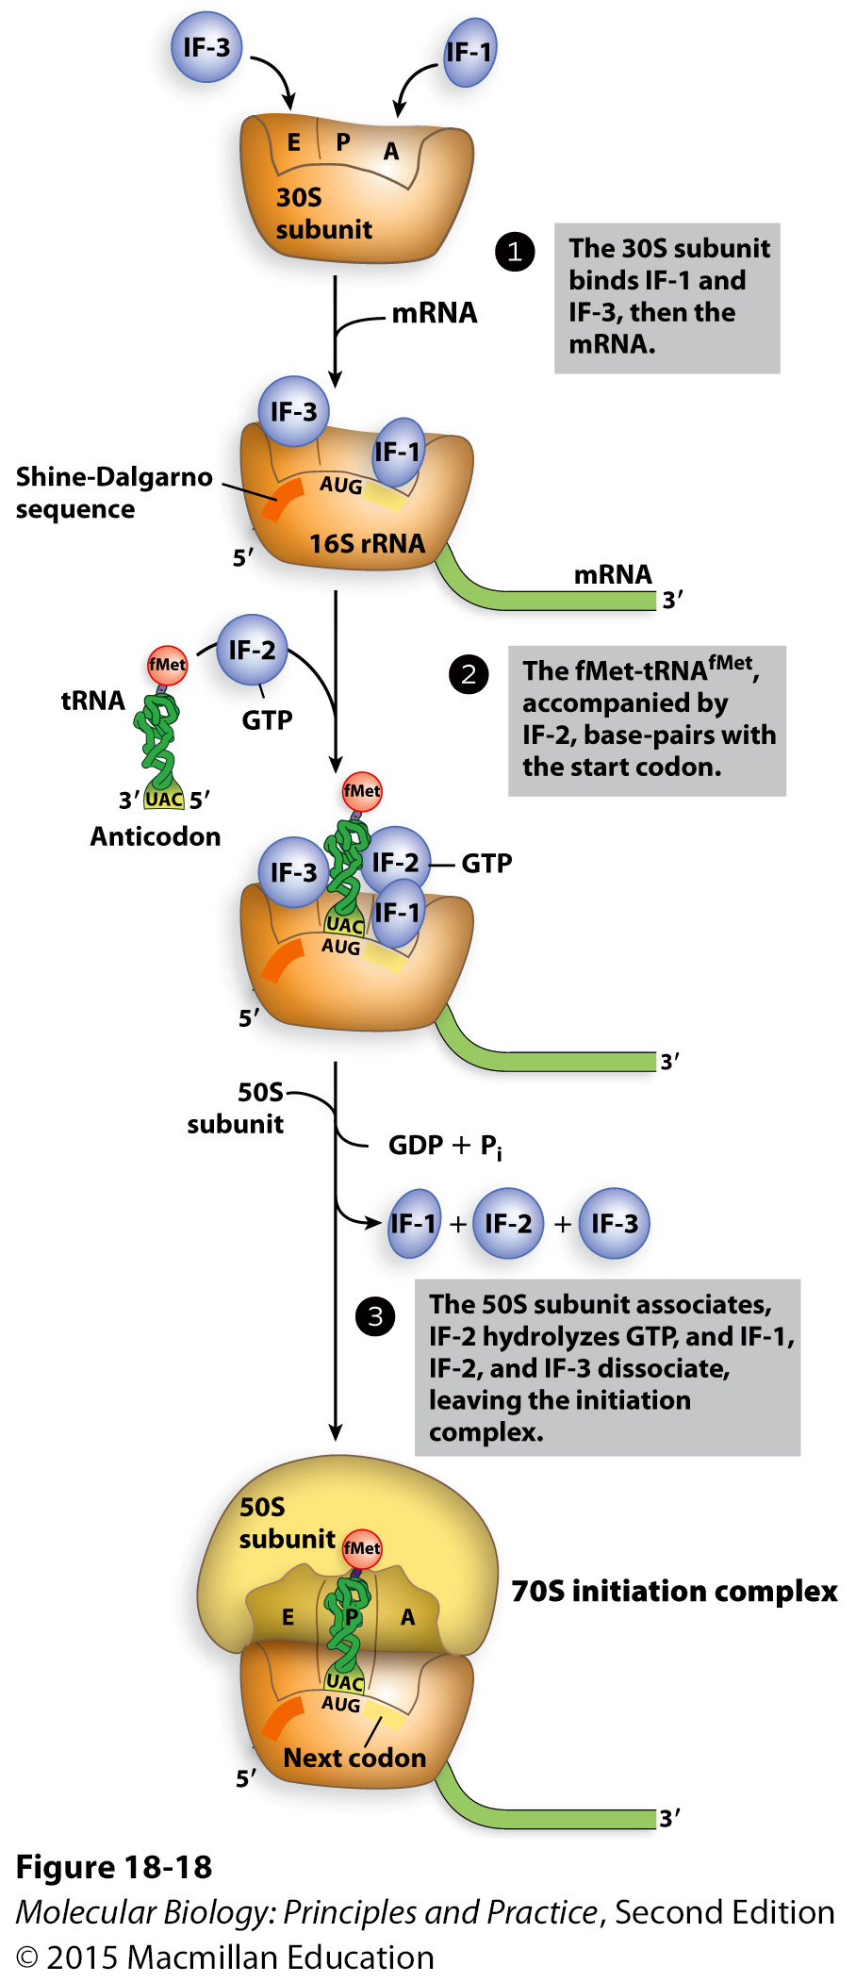
Initiation requires protein Initiation Factors

Slide 14
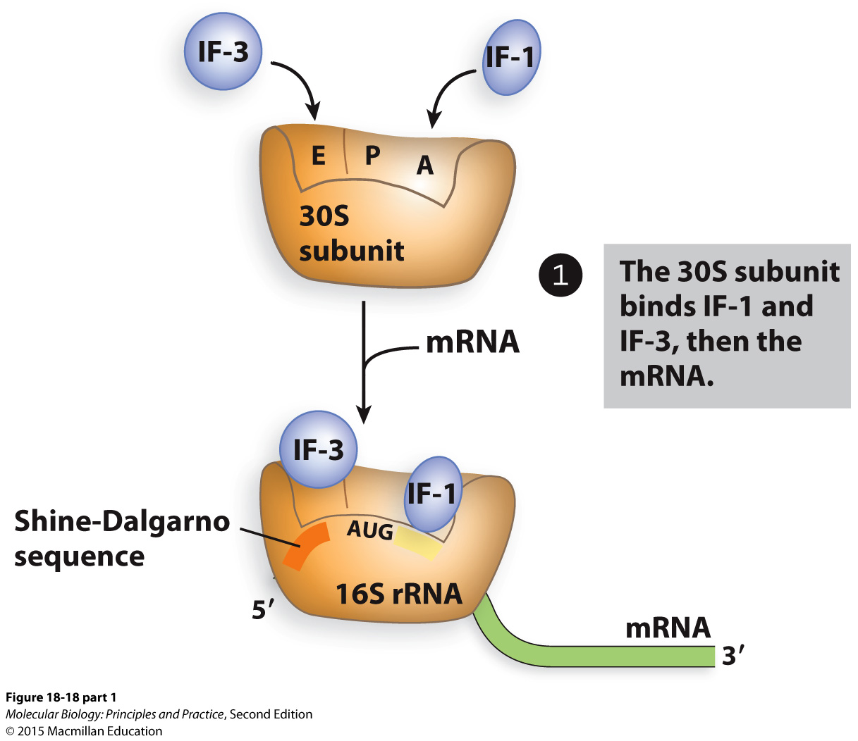
Initiation in bacteria

Slide 15
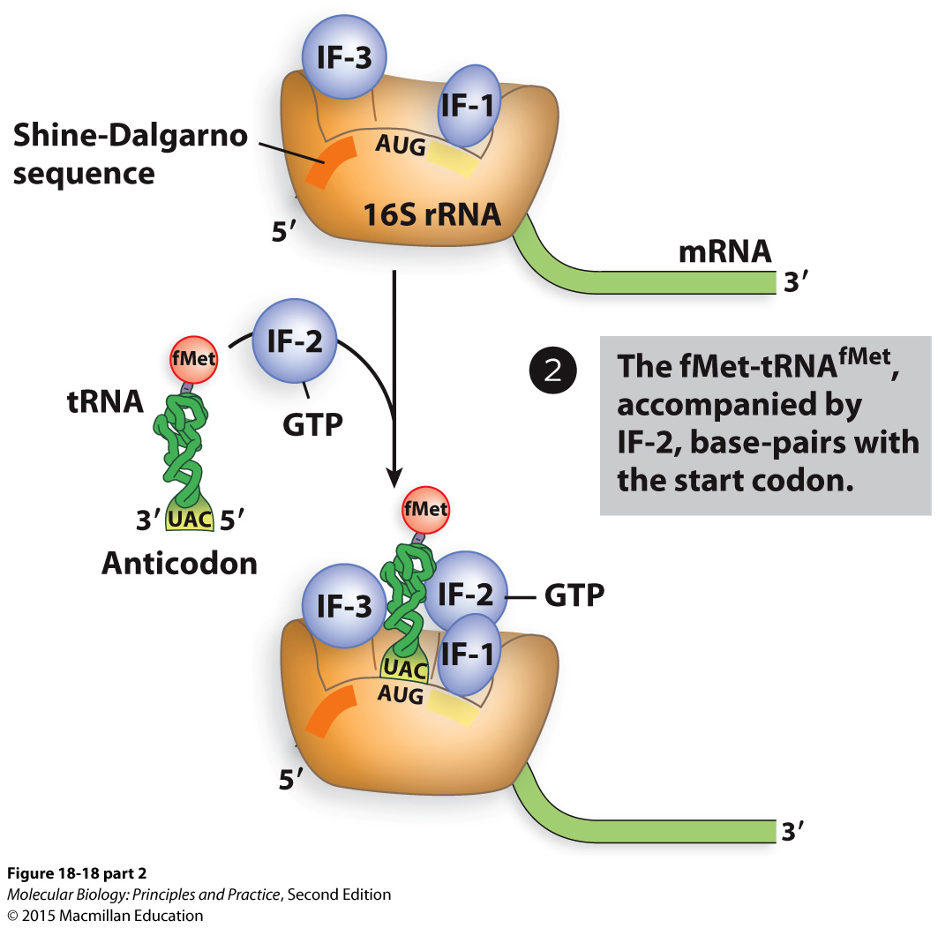
Initiation in bacteria

Slide 16
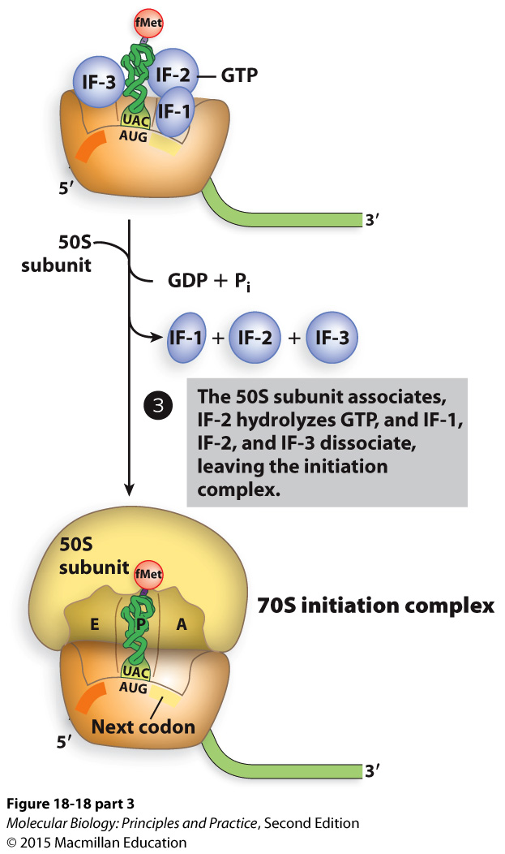
Initiation in bacteria

Slide 17
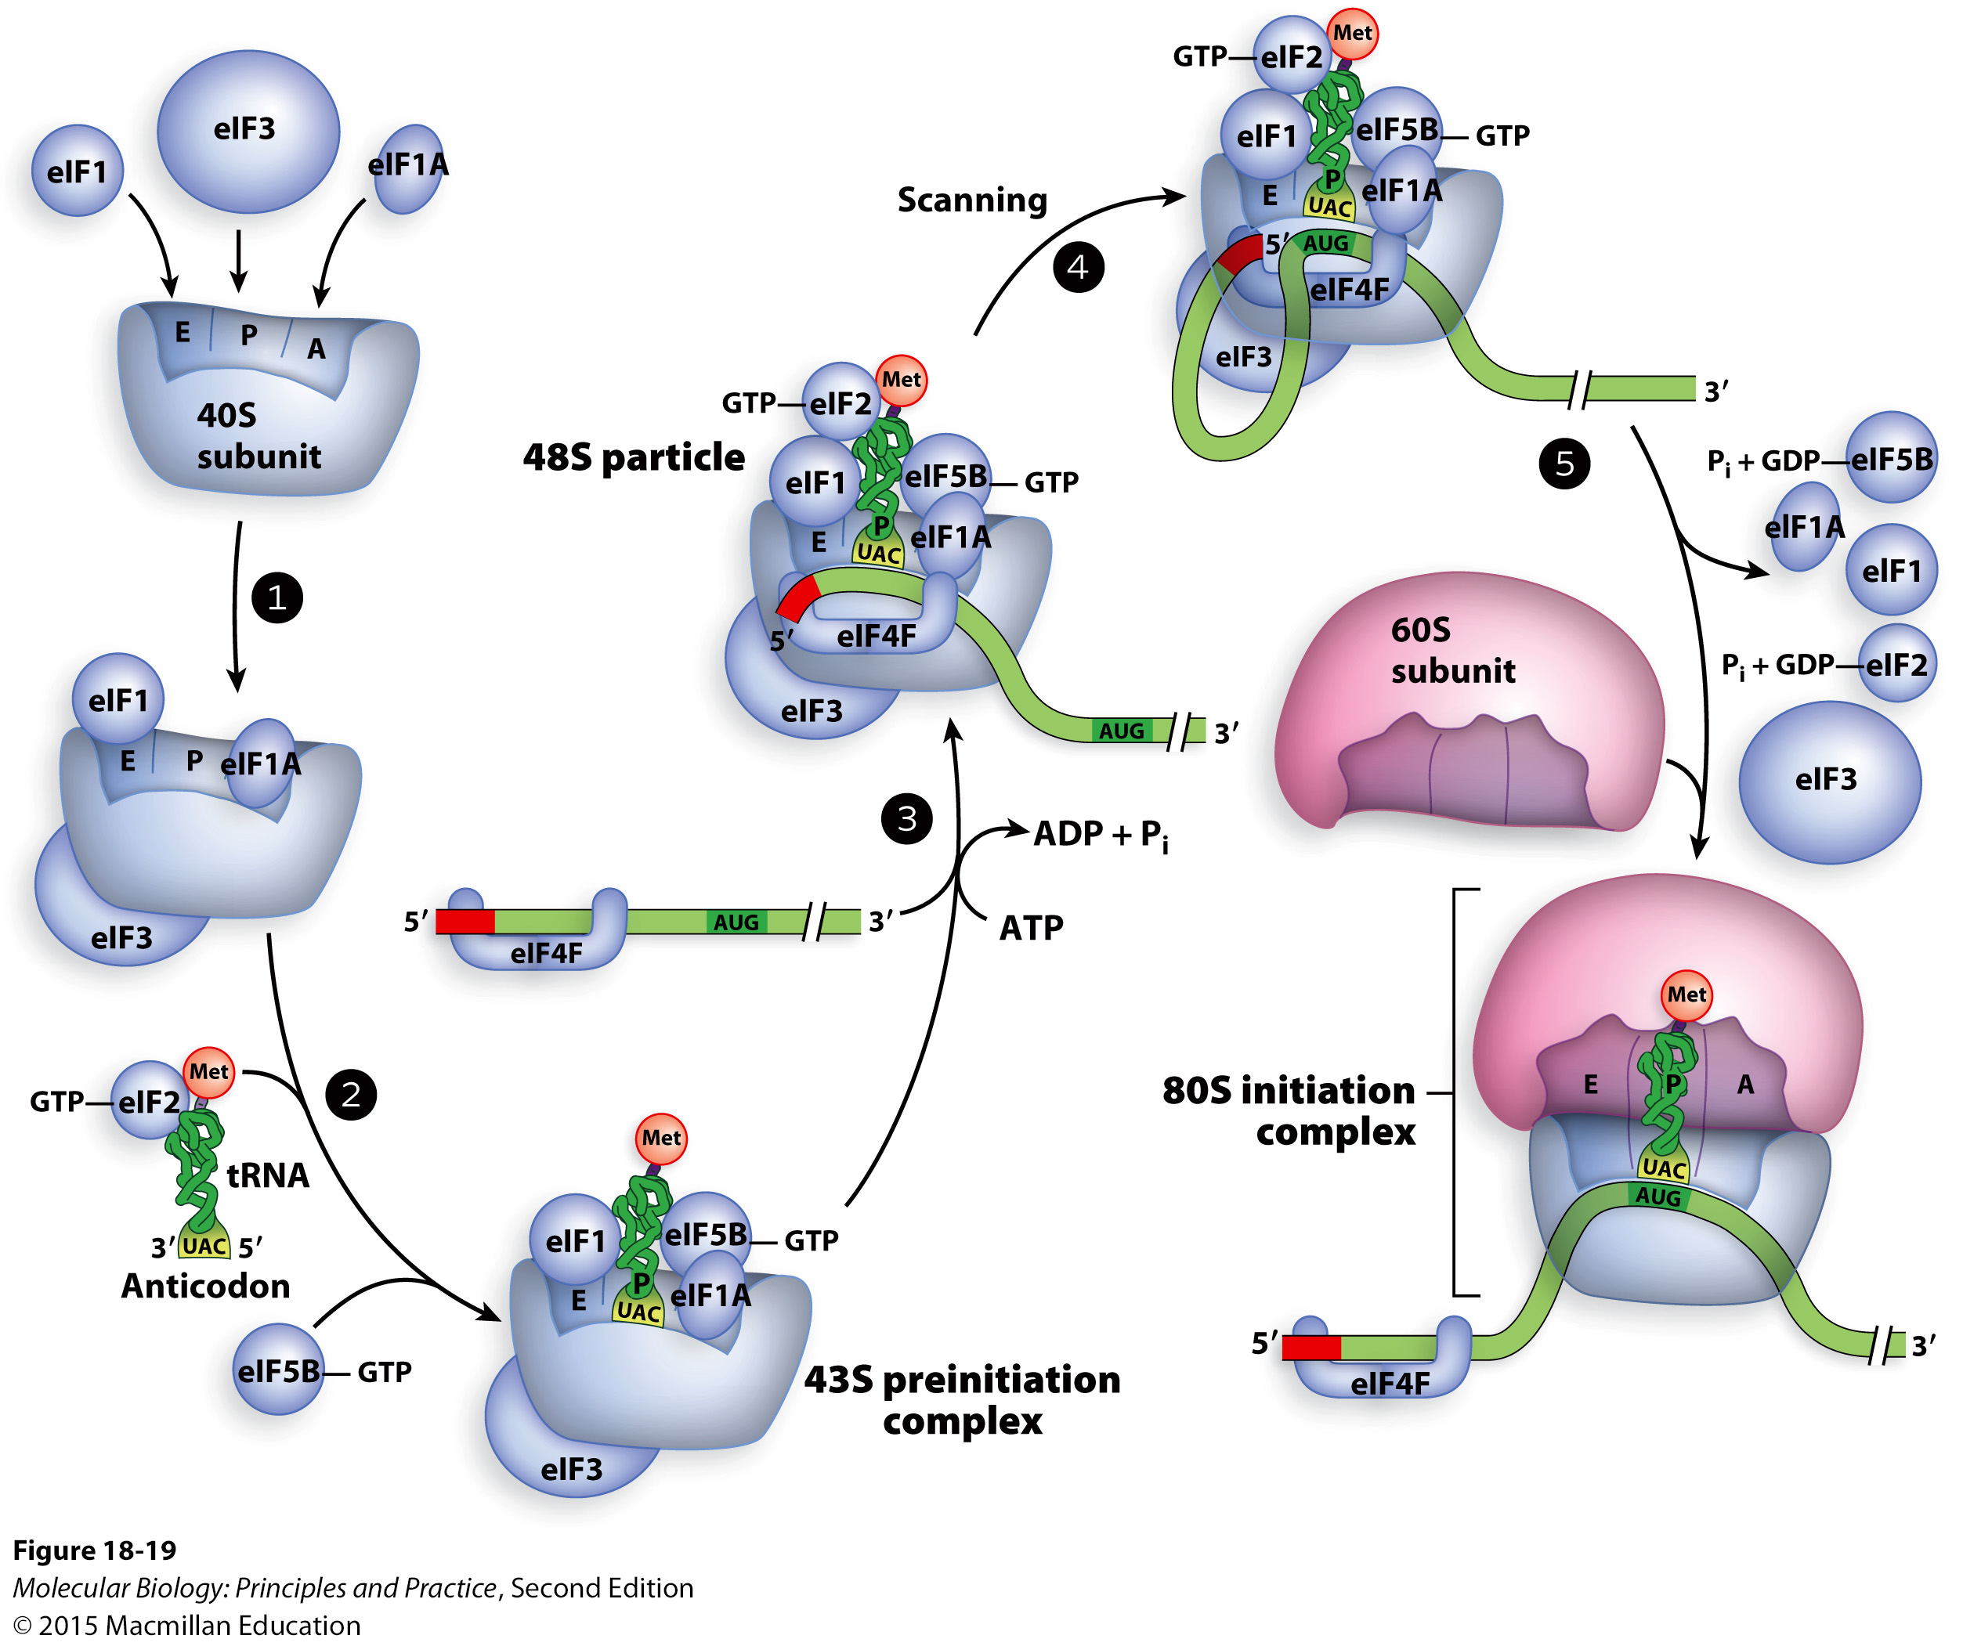
Initiation in eukaryotes

Slide 18
Initiation in eukaryotes – key steps:
40S (small) subunit binds initiation factors and initiator tRNA.
An initiation factor complex binds 5’ cap and poly(A) binding protein, brings mRNA to 40S complex.
mRNA is scanned from the 5’ end to find the first AUG, which base-pairs with anticodon.
Most of the initiation factors dissociate, the 60S (large) subunit binds to form a complete ribosome.

Slide 19
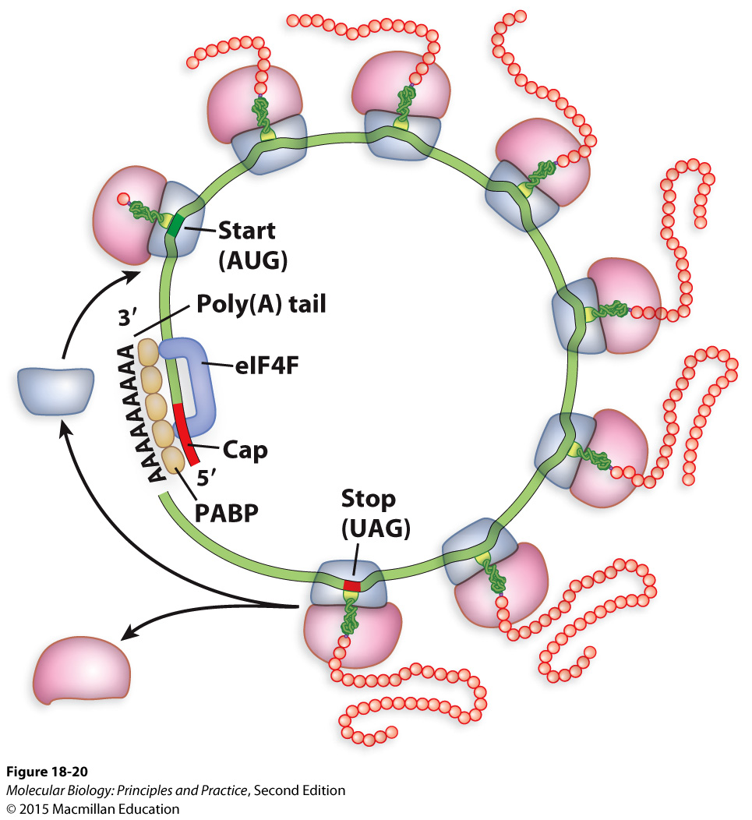
Simultaneous binding of cap and PABP by eIF4F

Slide 20
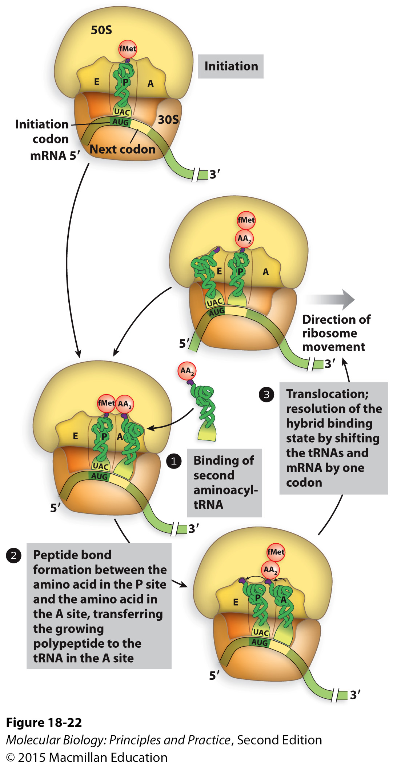
An overview of elongation
Notes:
Which way is the mRNA moving?
Which ways are the tRNAs moving?
Which positions does the initiator tRNA occupy, in what order? The subsequent tRNAs?

Slide 21
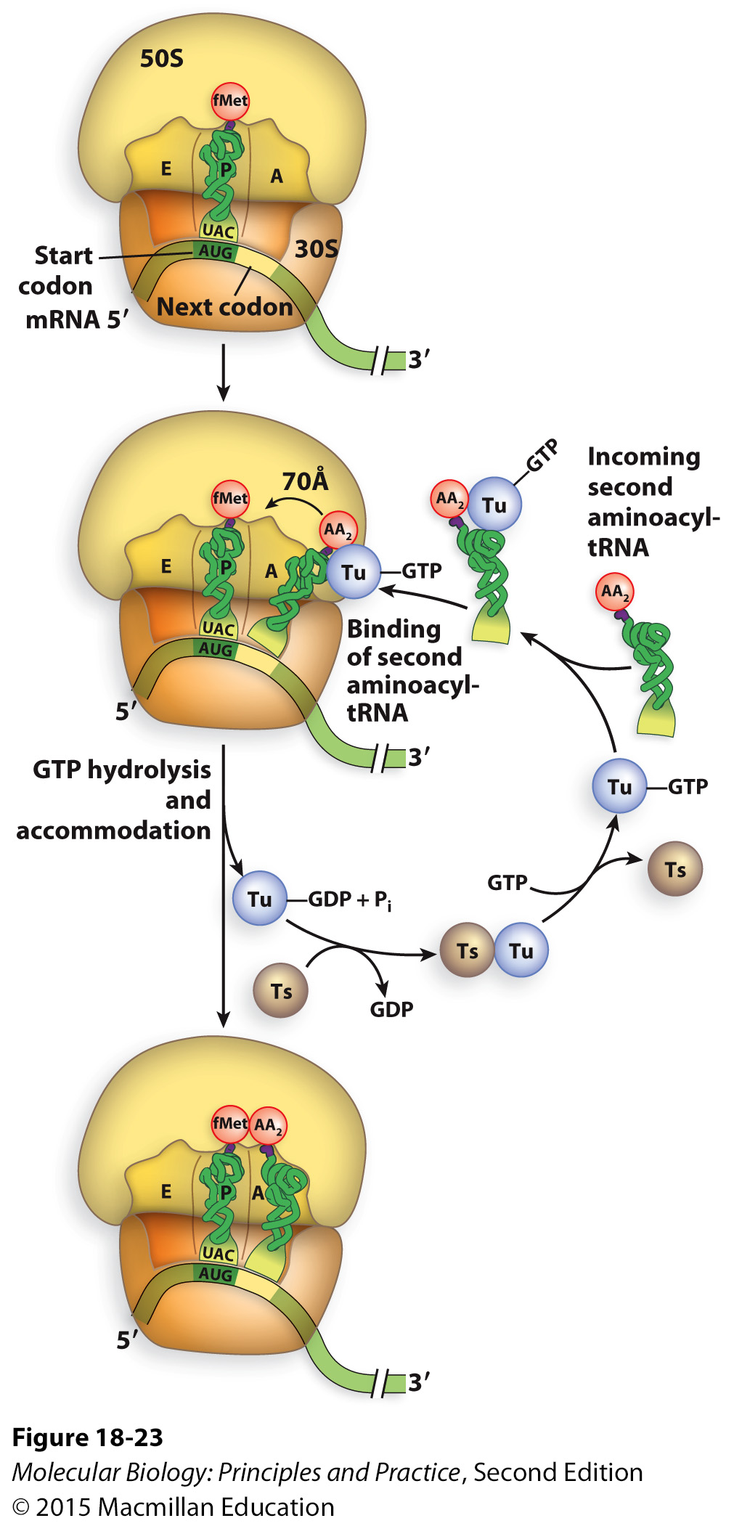
Elongation requires Elongation Factors (EFs) and GTP hydrolysis
Notes:
EF-Tu: bringing in new tRNA
As in initiation, tRNAs don’t enter the ribosome spontaneously – need proteins to bring them in.
EF-Ts: guanine nucleotide exchange factor.

Slide 22
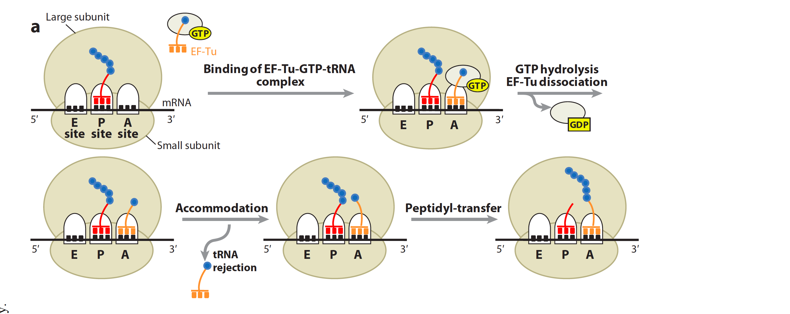
Another view of elongation
Leung et al. Annual Review of Biochemistry Vol. 80 (2011): 527-555
Notes:
The bond between the amino acid and the tRNA at the P site is broken
The C-term of the P-site amino acid or peptide becomes bonded to the N-term of the amino acid in the A site
The amino acid or peptide that was in the P site is now covalently linked to the amino acid that is covalently linked to the tRNA in the A site

Slide 23
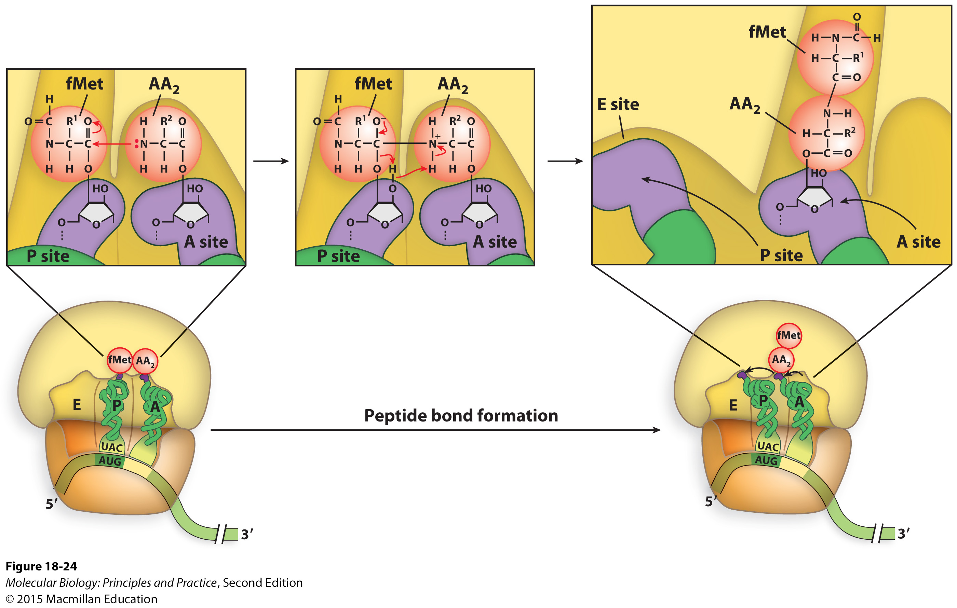
The chemistry of peptide bond formation
Notes:
The bond between the amino acid and the tRNA at the P site is broken
The C-term of the P-site amino acid or peptide is joined to the N-term of the amino acid in the A site
The amino acid or peptide that was in the P site is now covalently linked to the amino acid that is covalently linked to the tRNA in the A site

